Slide 1

EARTHQUAKE PREDICTION MODEL USING PYTHON
PHASE3 PROJECT

Slide 2
PREPARED BY
S.RAJALAKSHMI,
510521205031,
BHARATHIDASAN ENGINEERING COLLEGE,
PHASE3 PROJECT.

Slide 3

ITDRODUCTION
T

Slide 4
Loading and processing the dataset is a crucial step in earthquake prediction, as it lays the foundation for building accurate models and making informed decisions. In this critical phase of the research, we gather, prepare, and manipulate the data to extract meaningful insights.
The dataset may encompass a wide range of variables, such as seismic activity, geological features, historical earthquake records, and more. Proper data preprocessing involves tasks like cleaning, normalization, and feature engineering, which aim to enhance the dataset's quality and relevance. By preparing the data effectively, we can pave the way for advanced machine learning models and statistical analyses to predict earthquakes and contribute to disaster mitigation efforts.

Slide 5
Loading and processing the dataset is a crucial step in earthquake prediction, as it lays the foundation for building accurate models and making informed decisions. In this critical phase of the research, we gather, prepare, and manipulate the data to extract meaningful insights. The dataset may encompass a wide range of variables, such as seismic activity, geological features, historical earthquake records, and more. Proper data preprocessing involves tasks like cleaning, normalization, and feature engineering, which aim to enhance the dataset's quality and relevance. By preparing the data effectively, we can pave the way for advanced machine learning models and statistical analyses to predict earthquakes and contribute to disaster mitigation efforts.

Slide 6
GIVEN DATASET

Slide 7
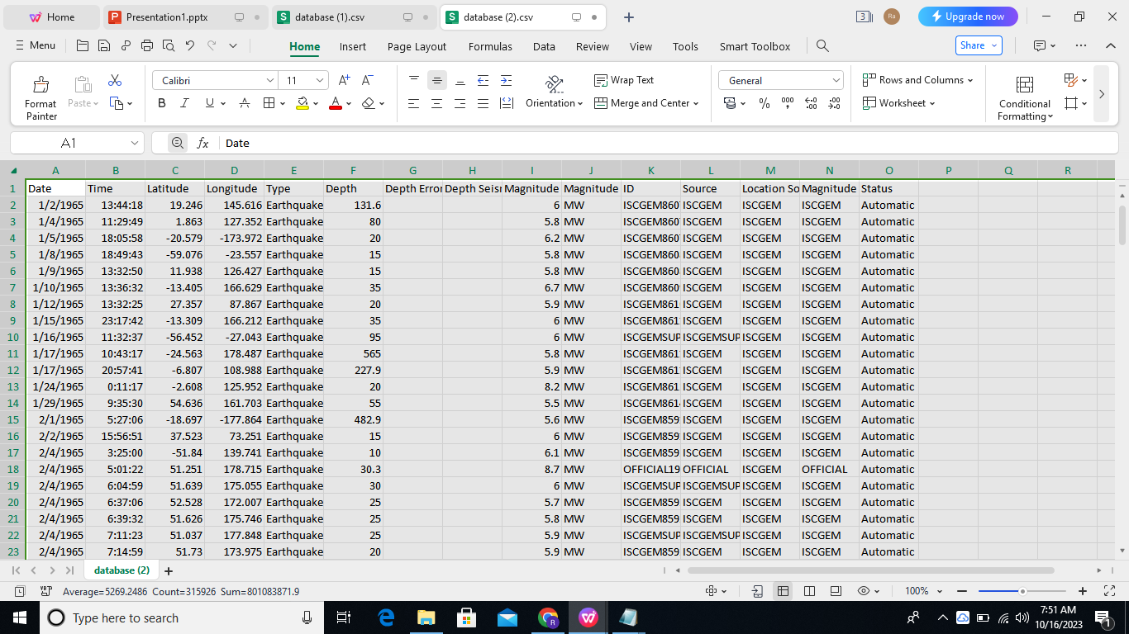

Slide 8
LOADING AND PREPROCESSING DATASET STEPS

Slide 9
Loading and preprocessing a dataset for earthquake prediction involves several essential steps. Here's an overview of the process:
1. Data Collection: Gather earthquake-related data, which typically includes seismic sensor readings, geological information, and historical earthquake records. This data can be obtained from various sources like government agencies, research institutions, or public databases.
2. Data Cleaning:
- Remove duplicates and irrelevant data points.
- Handle missing data by imputing or removing them.
- Check for outliers and decide whether to correct or remove them.
3. Feature Selection/Engineering:
- Select relevant features for earthquake prediction, such as seismic readings, fault line locations, geological features, and historical earthquake data.
- Create new features if needed, like earthquake frequency in a region over time.
4. Data Transformation:
- Standardize or normalize numerical features to have a consistent scale.
- Encode categorical variables if present.
- Perform time-series-specific data transformations if your data contains temporal information.

Slide 10
5. Splitting the Data:
- Divide the dataset into training, validation, and testing sets to assess the model's performance accurately.
6. Data Augmentation (Optional):
- Generate additional data points or variations to improve the model's robustness, especially if the dataset is small.
7. Balancing the Data (Optional):
- If your dataset is imbalanced (e.g., rare earthquakes), consider techniques like oversampling, undersampling, or using weighted loss functions.
8. Data Preprocessing for Time Series(If applicable):
- Ensure that the data is sorted by timestamp.
- Consider creating sequences or windows of data for training recurrent neural networks (RNNs) or similar models.
9. Data Visualization:
- Visualize the dataset to gain insights into its characteristics and potential patterns.
10. Data Splitting:
- Split the data into training, validation, and test sets.

Slide 11
11. Scaling:
- Apply scaling to ensure that features have similar scales for modeling.
12. Model-Specific Preprocessing:
- Some models may require specific preprocessing steps. For example, a convolutional neural network (CNN) might need image data, while an LSTM might need sequence data.
13. Save Preprocessing Steps:
- Save preprocessing information (e.g., mean and standard deviation for scaling) to apply to future data during inference.
These steps are crucial for preparing your dataset for earthquake prediction. The choice of techniques and tools may vary based on the specific requirements of your project and the machine learning model you plan to use.

Slide 12
loading and preprocessing the dataset program

Slide 13
import pandas as pd
Preprocessing steps
# loading the dataset into a dataframe
df = pd.read_csv(r'/kaggle/input/usgs-dataset-for-earthquake-30-days/Earthquake_of_last_30 days.csv')
# Display the first 5 rows of data
df.head()
time latitude longitude depth mag magType nst gap dmin rms ... updated place type horizontalError depthError magError magNst status locationSource magSource
0 2023-02-14T21:31:52.124Z 60.828300 -151.841200 85.00 2.20 ml NaN NaN NaN 1.6100 ... 2023-02-14T21:35:21.982Z 33 km WNW of Nikiski, Alaska earthquake NaN 2.10 NaN NaN automatic ak ak
1 2023-02-14T20:45:56.420Z 19.254333 -155.410828 31.32 2.27 ml 41.0 139.00 NaN 0.1500 ... 2023-02-14T20:51:26.040Z 9 km NE of Pahala, Hawaii earthquake 0.66 0.81 2.790 10.0 automatic hv hv
2 2023-02-14T20:45:12.919Z 38.146900 -117.982000 7.30 1.90 ml 11.0 110.46 0.02000 0.1385 ... 2023-02-14T21:04:41.699Z Nevada earthquake NaN 1.30 0.210 9.0 reviewed nn nn
3 2023-02-14T20:43:53.796Z 63.898700 -148.655300 82.40 1.30 ml NaN NaN NaN 0.5700 ... 2023-02-14T20:46:28.820Z 15 km ENE of Healy, Alaska earthquake NaN 1.50 NaN NaN automatic ak ak
4 2023-02-14T20:43:40.220Z 33.324167 -116.757167 12.42 0.89 ml 23.0 67.00 0.08796 0.1700 ... 2023-02-14T21:22:42.029Z 9km N of Lake Henshaw, CA earthquake 0.26 1.00 0.133 8.0 reviewed ci ci
5 rows × 22 columns

Slide 14
# Display the last 5 rows of data
df.tail()
time latitude longitude depth mag magType nst gap dmin rms ... updated place type horizontalError depthError magError magNst status locationSource magSource
10148 2023-01-15T21:45:41.552Z 41.507200 19.986200 10.000 4.10 mb 32.0 40.0 0.1850 0.66 ... 2023-01-26T02:26:34.175Z Albania earthquake 4.68 1.972 0.301 3.0 reviewed us us
10149 2023-01-15T21:42:53.540Z 33.323167 -116.900333 19.470 1.28 ml 42.0 39.0 0.1282 0.16 ... 2023-01-17T23:04:14.863Z 5km SW of Palomar Observatory, CA earthquake 0.18 0.500 0.223 23.0 reviewed ci ci
10150 2023-01-15T21:42:37.119Z 62.524300 -149.442100 50.900 1.10 ml NaN NaN NaN 0.48 ... 2023-01-30T21:47:30.436Z 35 km ENE of Chase, Alaska earthquake NaN 0.600 NaN NaN reviewed ak ak
10151 2023-01-15T21:39:04.248Z 63.160500 -150.495600 112.900 1.70 ml NaN NaN NaN 0.40 ... 2023-01-30T21:47:30.191Z 74 km SE of Denali National Park, Alaska earthquake NaN 0.400 NaN NaN reviewed ak ak
10152 2023-01-15T21:37:21.608Z 41.451300 19.999500 16.295 4.90 mb 105.0 37.0 0.1460 0.74 ... 2023-02-12T22:12:07.662Z 9 km SW of Klos, Albania earthquake 4.32 3.590 0.072 60.0 reviewed us us
5 rows × 22 columns

Slide 15
# Display the shape of the data (number of rows and columns)
df.shape
(10153, 22)
# Display the column names
df.columns
Index(['time', 'latitude', 'longitude', 'depth', 'mag', 'magType', 'nst',
'gap', 'dmin', 'rms', 'net', 'id', 'updated', 'place', 'type',
'horizontalError', 'depthError', 'magError', 'magNst', 'status',
'locationSource', 'magSource'],
dtype='object')
# Display the data types of each column
df.dtypes
time object
latitude float64
longitude float64
depth float64
mag float64
magType object
nst float64
gap float64
dmin float64
rms float64
net object
id object

Slide 16
For bivariate analysis, we can look at the relationship between two variables in the dataset.
Bivariate Analysis:
import matplotlib.pyplot as plt
# Scatter plot of depth vs magnitude
plt.scatter(df['depth'], df['mag'])
plt.xlabel('Depth')
plt.ylabel('Magnitude')
plt.title('Scatter plot of Depth vs Magnitude')
plt.show()
# Box plot of earthquake magnitude by type
df.boxplot(column='mag', by='type')
plt.title('Box plot of Earthquake Magnitude by Type')
plt.suptitle('')
plt.show()
Multivariate Analysis:
import seaborn as sns
import matplotlib.pyplot as plt
# Select the numerical columns for correlation analysis
numeric_cols = ['latitude', 'longitude', 'depth', 'mag', 'nst', 'gap', 'rms', 'horizontalError', 'depthError']
# Create correlation matrix
corr_matrix = df[numeric_cols].corr()
# Plot heatmap
sns.heatmap(corr_matrix, annot=True, cmap='coolwarm')
plt.title('Correlation Matrix')
plt.show()

Slide 17
Data Visualization:
import seaborn as sns
import matplotlib.pyplot as plt
# Set style for all visualizations
sns.set_style("darkgrid")
# Scatter plot to show relationship between magnitude and depth
sns.scatterplot(data=df, x="mag", y="depth")
# Bar plot to show distribution of magnitudes
sns.histplot(data=df, x="mag")
# Box plot to show distribution of magnitudes by type
sns.boxplot(data=df, x="magType", y="mag")
# Heatmap to show correlation between variables
corr = df.corr()
sns.heatmap(corr, annot=True)
# Pairplot to show scatterplots of all possible variable combinations
sns.pairplot(df)
# Show all visualizations
plt.show()

Slide 18
DATA VISUALIZATION

Slide 19
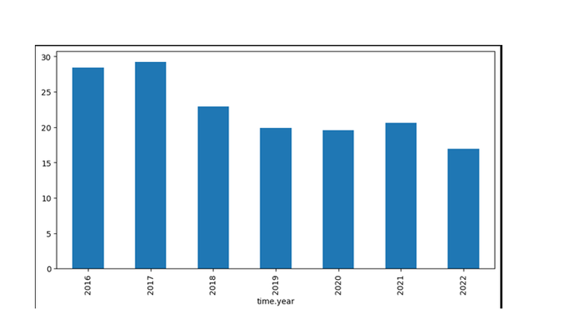
import pandas as pdd
import numpy as npp
import matplotlib.pyplot as pltt
import seaborn as sbb
pltt.figure(figsize=(10, 5))
x1 = df1.groupby('time.year').mean()['location.depth']
x1.plot.bar()
pltt.show()
Output:

Slide 20
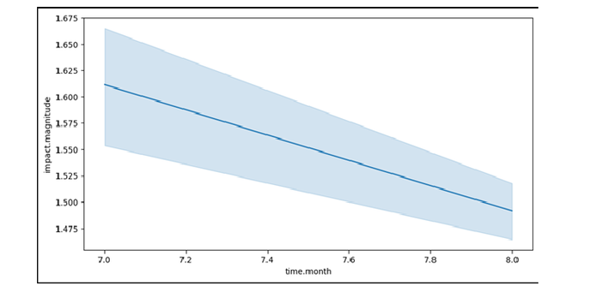
pltt.figure(figsize=(10, 5))
sbb.lineplot(data=df1,
x='time.month',
y='impact.magnitude')
pltt.show()
output:

Slide 21
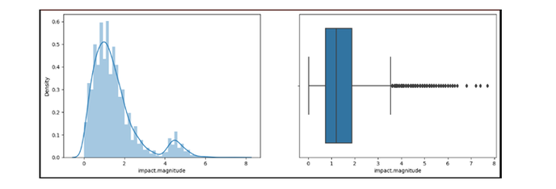
pltt.subplots(figsize=(15, 5))
pltt.subplot(1, 2, 1)
sbb.distplot(df1['impact.magnitude'])
pltt.subplot(1, 2, 2)
sbb.boxplot(df1['impact.magnitude'])
pltt.show()
output:

Slide 22
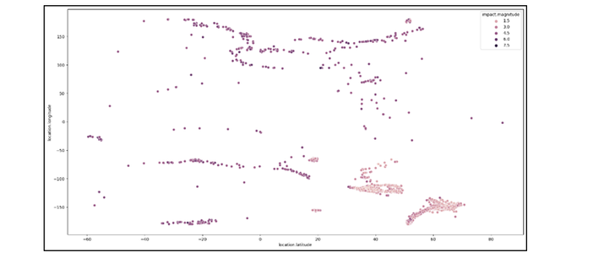
pltt.figure(figsize=(20, 10))
sbb.scatterplot(data=df1,
x='location.latitude',
y='location.longitude',
hue='impact.magnitude')
pltt.show()
output:

Slide 23
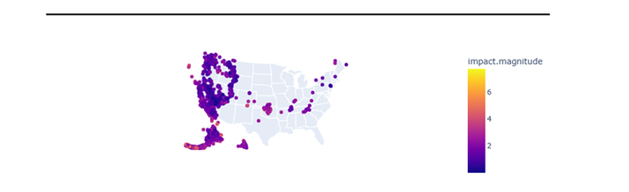
import plotly.express as pxx
import pandas as pdd
fig_w = pxx.scatter_geo(df1, lat='location.latitude',
lon='location.longitude',
color="impact.magnitude",
scope='usa')
fig_w.show()
output:

Slide 24
CONCLUSION

Slide 25
In conclusion, the loading and preprocessing of datasets for earthquake prediction is a foundational process in developing accurate and reliable predictive models. It involves several key steps, including data collection, cleaning, integration, feature extraction, normalization, splitting, and model training. The dataset must be carefully prepared to ensure data quality and suitability for machine learning models.
The specific tools and techniques used in this process will depend on the nature of the data sources, the chosen infrastructure (whether IoT or cloud-based), and the project's requirements. Effective data loading and preprocessing are essential for the successful development and deployment of earthquake prediction models. These models have the potential to provide valuable insights and early warnings, contributing to disaster management and public safety.

Slide 26
THANKS

